Slide 1
Business Continuity Management (BCM)
Corporate Audit Team
January 2011

Slide 2
Today’s Agenda
Background
What to expect
Define Business Continuity Management (BCM)
BCM Infrastructure
Scenarios we plan for
Quality organization approach to BCM
What happens when an event occurs ?
How can I make sure that I am ready ?

Slide 3
Background
Global program
To plan for events that may interrupt ‘normal’ business
Led by Ricardo Navarrete and David Stowe
Regional workshops
Local location workshops

Slide 4
At each location….what to expect
Site Business Continuity Coordinator (SBCC)
BCM Plan for each significant function present
Held in the Corporate BCM tool ‘Ops Planner’
Reviewed 6 monthly
Global plans for some functions: e.g Field Operations, Commercial, Quality

Slide 5
Risks and threats that UL is exposed to
Risks mitigated with tools and controls
These risks are frequent to organizations
and are mitigated with common controls.
UL has these in place.
Virus
Data corruption
Risks mitigated with some redundancy
These risks are less common to organizations
and are partially mitigated with redundancy and
basic tools. UL generally has these in place.
Application
outage
Disk failure
Frequent
Human error
Component failure
Heart Attack
Network problem
Frequency of
occurrences
per year
Hacking
Power failure
Transportation
disruption
Flooding
Tornado
Building fire
Hurricane
Earthquake
Terror
Typhoon
Risks cannot be mitigated
These risks are infrequent but are very impactful
to organizations but can’t be mitigated with
common tools and controls.
This is where BCM is necessary.
Pandemic flu
Infrequent
$1 $10 $100 $1,000 $10k $100k $1M $10M $100M
Level of Impact
Low
High

Slide 6
Define Business Continuity Management (BCM)
  “The ability and readiness to manage business interruptions, in order to provide continuity of services……………
  at a minimum acceptable level and to safeguard the financial and competitive position in the short and longer term. It includes the organization in place to ensure the continuous adaptation to changing risks, changing environment and co-ordination of regular training and testing.”
Business Continuity Objectives
Safety & well being of employees
Ongoing service to customers
Survival of the mission

Slide 7
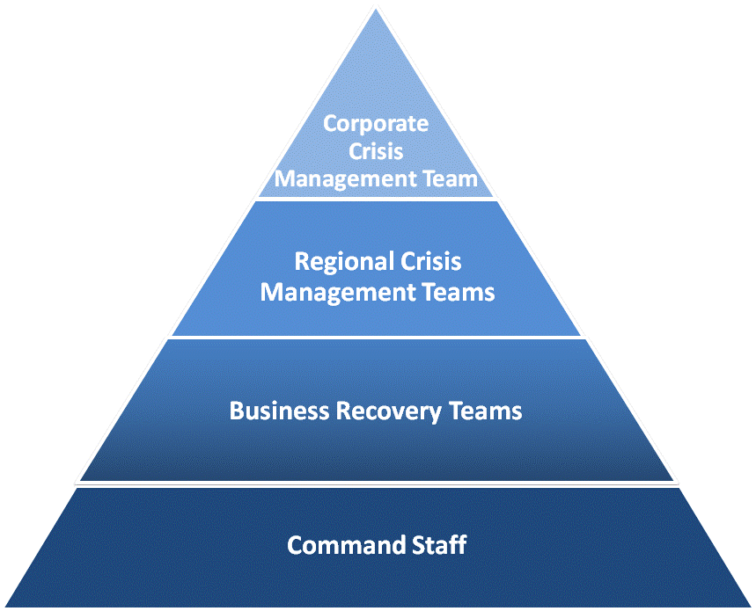
BCM Infrastructure - People
North America:
Al Cotrone
EULA
Hamid Syed
Asia:
Paul Ngai
Oversight
Strategic Response
Resource Support
Tactical Response
Recovery
Incident Reporting
Site
Business
Continuity
Coordinator
Incident
Commander

Slide 8
BCM Infrastructure - Technology
‘Ops Planner’ Tool
UL Technology Environment
BCM Plan
Repository
Emergency
Notification
System
Paradigm Solutions International
Secure access from
any Internet access point

Slide 9
Scenarios we plan for:
Location outage (e.g. adverse weather)
System outage (e.g virus attack)
Staff outage (e.g. epidemic)

Slide 10
Quality organization approach to BCM
Global plan with local specifics
Add local specifics as they become available
Key processes | Owner
Accreditor and Notifier Management (Global and Local) | Keith Mowry
Corrective Action Request (CAR) Process (External and Internally generated CARS) | Denise Echols
Corporate Internal Audit Program | Denise Echols
Corporate Internal Technical Audit | Lenore Berman
Corporate Document Control | John Jones
Global Forms Library | John Jones
Local Quality Specifics | Various

Slide 11
Quality organization approach to BCM
For each key process, we identify:
    Recovery Time Objective
    Impacts if the process is inactive
    Dependencies

Slide 12
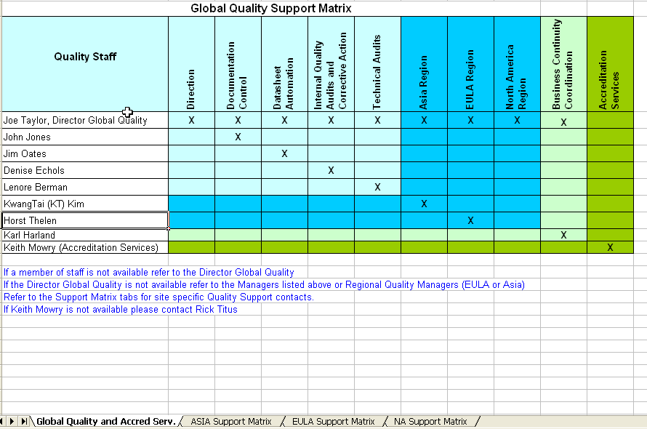
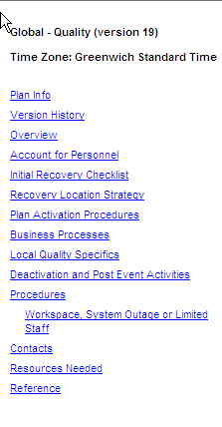
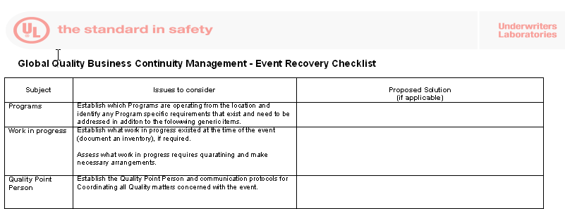
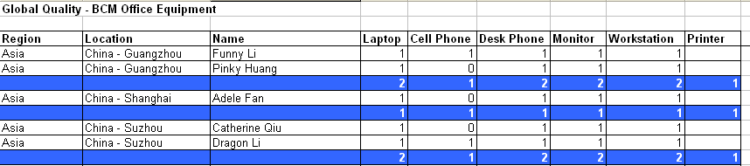
Quality organization approach to BCM
Deputies
Event checklist
Resources

Slide 13
What happens when an event occurs ?
Incident Commander
    Makes safe and secures location
    Communicates position to local staff
Site Business Continuity Coordinator (SBCC)
    Activates relevant BCM Plans (Including Global Quality Plan)
    Convenes business recovery team
    Escalates as required
    Communicates with Regional and Global Crisis Management Teams
    Coordinates action needed to return to normal operations
    Deactivates the event
    Conducts post event review
Quality Point Person:
    Evaluates impact on Quality
    Determines what is needed to return to normal operations
    Supports Business Recovery Team

Slide 14
How can I make sure that I am ready ?
Review the Quality BCM Plan (suggest any improvements)
Identify your Site Business Continuity Coordinator
Volunteer your contact details for the Emergency Notification System:
    Be first to know if an event has occurred
    Used only for this purpose
    Held securely in Ops Planner
    Shortly invite you to provide contact details
Find out more: BCM Intranet site

Slide 15


Slide 17
Business Continuity Roles
Site Business Continuity Coordinator
The SBCC is responsible for overseeing the Business Continuity Program for their respective site.
Ensure that all necessary plans are developed, maintained and tested
Be the main point of contact and responsible party for the site BC Program during normal operations and during an business interruption or disaster,
Coordinate with the Command Staff and Business Recovery Leads
Continuously communicate with RBCC and GBCC
Incident Commander
The Incident Commander is responsible for overseeing the Command Staff at their respective site.
Oversight of building evacuations, local staff communications, relocation, etc
Perform damage assessment when safety and emergency services permit it
Organize restoration strategy, obtain approval, funding & resources from executive/corporate teams
Coordinate with Emergency Services, Business Recovery Teams and SBCC

